Slide 1
Bar Elements
Gebril El-Fallah
EG3111 – Finite Element Analysis and Design
gmae2@leicester.ac.uk

Slide 2
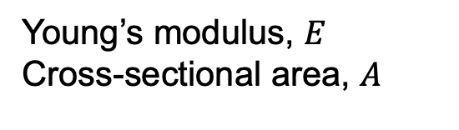


3. Bar Elements
Length, $L$
Load, $P$
Young’s modulus, $E$
Cross-sectional area, $A$
We have already considered the problem of a bar under extension/compression in section 2.
However, we do not wish to be formulating the total energy each time (especially for systems with many DOF) and hence wish to construct the FEM for general bar elements within a formal mathematical framework.
This framework will also help us later on when we wish to develop other types of element, e.g beam, solid, shell.

Slide 3





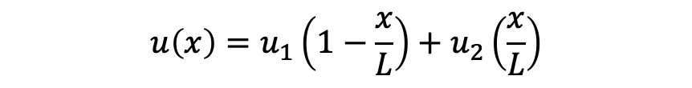
3a. General Bar Element
Length, $L$
Load, $P$
$$x$$
Bar element
$$u_{1}$$
Element
$$u_{2}$$
Linear shape function
Nodes
$$u\left(x\right)=u_{1}\left(1−\frac{x}{L}\right)+u_{2}\left(\frac{x}{L}\right)$$

Slide 4

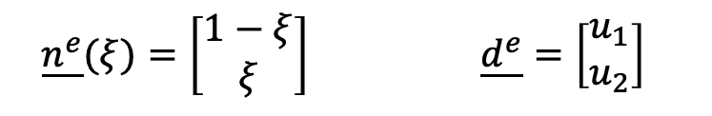



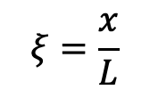

3a. General Bar Element
Local variable, $ξ$
$$ξ=\frac{x}{L}$$
$$ξ=0$$
$$ξ=1$$
$$u\left(ξ\right)=u_{1}\left(1−ξ\right)+u_{2}ξ$$
$$⟹$$
$$u\left(ξ\right)=\underline{{n^{e}}^{T}}.\underline{d^{e}}$$
$$\underline{n^{e}}(ξ)=\left[\begin{aligned}1−ξ \\ ξ\end{aligned}\right] \underline{d^{e}}=\left[\begin{aligned}u_{1} \\ u_{2}\end{aligned}\right]$$
Elemental shape function matrix
Elemental DOF matrix

Slide 5
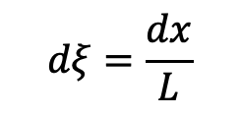

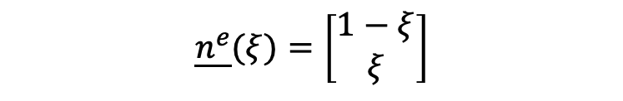







3a. General Bar Element
$$ξ=\frac{x}{L}$$
$$dξ=\frac{dx}{L}$$
$$dx=Ldξ$$
$$⟹$$
$$ξ=0$$
$$ξ=1$$
$$u\left(ξ\right)=u_{1}\left(1−ξ\right)+u_{2}ξ$$
$$u\left(ξ\right)=\underline{{n^{e}}^{T}}.\underline{d^{e}}$$
Where
$$\underline{n^{e}}(ξ)=\left[\begin{aligned}1−ξ \\ ξ\end{aligned}\right]$$
$$\underline{d^{e}}=\left[\begin{aligned}u_{1} \\ u_{2}\end{aligned}\right]$$
Check
$$u\left(ξ\right)=\underline{{n^{e}}^{T}}.\underline{d^{e}}$$
$$\left[\begin{aligned}u_{1} \\ u_{2}\end{aligned}\right]$$
$$=\left[1−ξ,ξ\right]$$
$$u\left(ξ\right)=\left[\left(1−ξ\right)u_{1}+ξu_{2}\right]$$
$$⟹$$

Slide 6
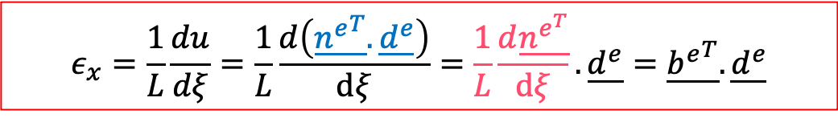
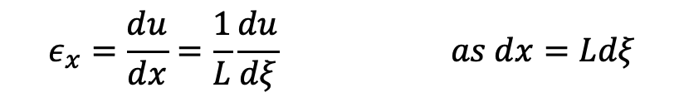
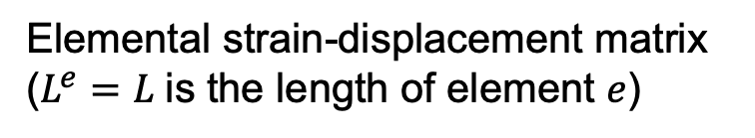
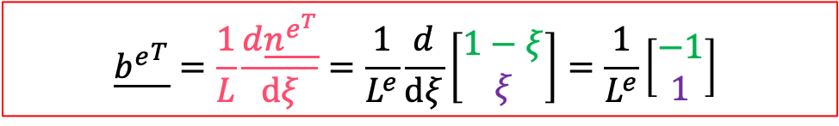
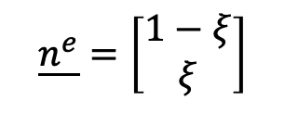
3a. General Bar Element
Strain-displacement matrix
$$ε_{x}=\frac{du}{dx}=\frac{1}{L}\frac{du}{dξ} as dx=Ldξ$$
$$ε_{x}=\frac{1}{L}\frac{du}{dξ}=\frac{1}{L}\frac{d\left(\underline{{n^{e}}^{T}}.\underline{d^{e}}\right)}{dξ}=\frac{1}{L}\frac{d\underline{n^{e^{T}}}}{dξ}. \underline{d^{e}}=\underline{{b^{e}}^{T}}.\underline{d^{e}}$$
Where
$$\underline{{b^{e}}^{T}}=\frac{1}{L}\frac{d\underline{n^{e^{T}}}}{dξ}=\frac{1}{L^{e}}\frac{d}{dξ}\left[\begin{aligned}1−ξ \\ ξ\end{aligned}\right]=\frac{1}{L^{e}}\left[\begin{aligned}−1 \\ 1\end{aligned}\right]$$
$$\underline{n^{e}}=\left[\begin{aligned}1−ξ \\ ξ\end{aligned}\right]$$
Elemental strain-displacement matrix ($L^{e}=L$ is the length of element $e$)

Slide 7
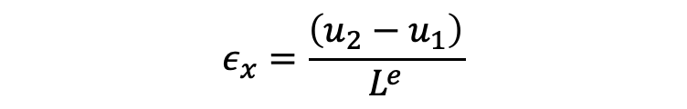
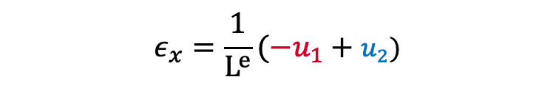
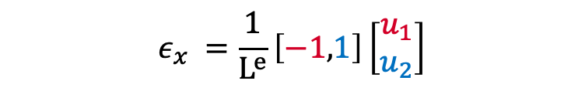
3a. General Bar Element
Check
$$ε_{x}=\underline{{b^{e}}^{T}}.\underline{d^{e}}$$
$$ε_{x} =\frac{1}{L^{e}}\left[−1,1\right]\left[\begin{aligned}u_{1} \\ u_{2}\end{aligned}\right]$$
$$ε_{x}=\frac{1}{L^{e}}({−u}_{1}+u_{2})$$
$$ε_{x}=\frac{\left(u_{2}−u_{1}\right)}{L^{e}}$$

Slide 8
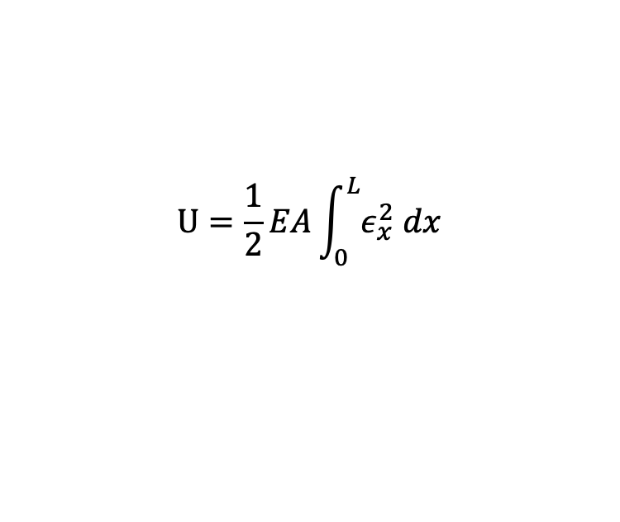
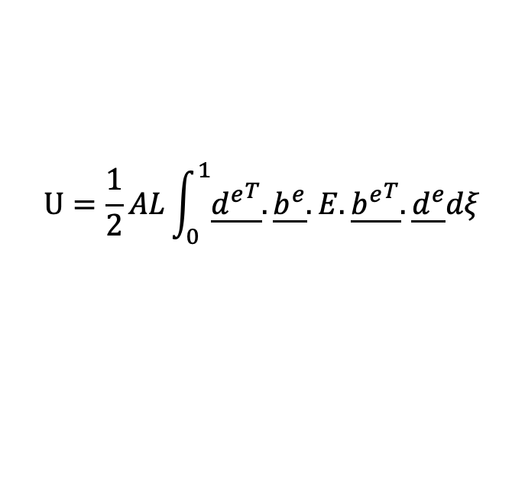
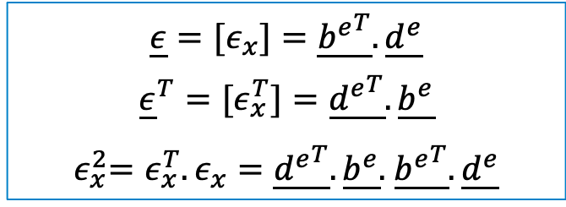


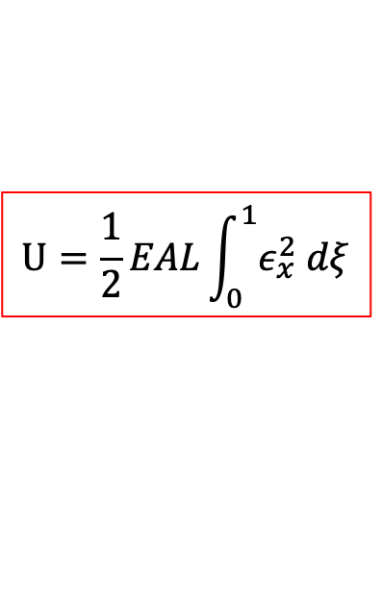
3a. General Bar Element
Elastic strain energy of an element
$$U=\frac{1}{2}EA\int_{0}^{L}{ε_{x}^{2} dx}$$
$$U=\frac{1}{2}EAL\int_{0}^{1}{ε_{x}^{2} dξ}$$
$$Eq 1$$
Where
$$\underline{ε}=[ε_{x}]=\underline{{b^{e}}^{T}}.\underline{d^{e}}$$
$${\underline{ε}}^{T}=[ε_{x}^{T}]=\underline{{d^{e}}^{T}}.\underline{b^{e}}$$
${ ε}_{x}^{2}=ε_{x}^{T}.ε_{x}=\underline{{d^{e}}^{T}}.\underline{b^{e}}.$ $\underline{{b^{e}}^{T}}.\underline{d^{e}}$
Substitute $ε_{x}^{2}$in $Eq 1$
$$U=\frac{1}{2}AL\int_{0}^{1}{\underline{{d^{e}}^{T}}.\underline{b^{e}}.E. \underline{{b^{e}}^{T}}.\underline{d^{e}}dξ}$$

Slide 9
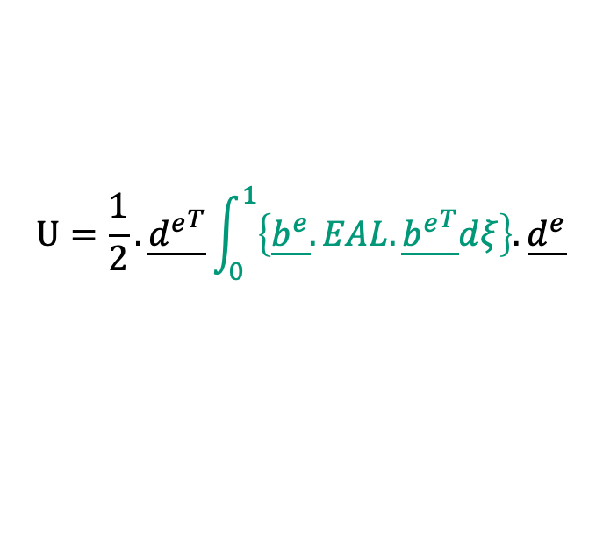
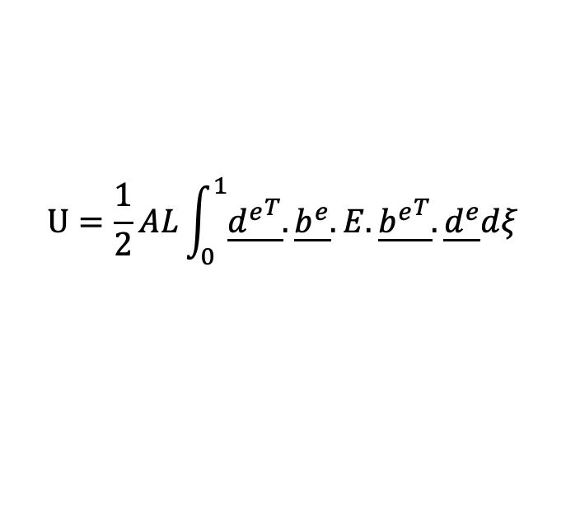
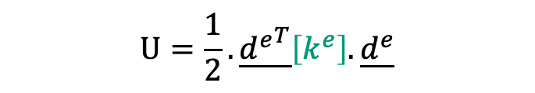
3a. General Bar Element
Elastic strain energy of an element
$$U=\frac{1}{2}AL\int_{0}^{1}{\underline{{d^{e}}^{T}}.\underline{b^{e}}.E. \underline{{b^{e}}^{T}}.\underline{d^{e}}dξ}$$
$$U=\frac{1}{2}.\underline{{d^{e}}^{T}}\int_{0}^{1}{\left\{\underline{b^{e}}.EAL. \underline{{b^{e}}^{T}}dξ\right\}.\underline{d^{e}}}$$
$$U=\frac{1}{2}.\underline{{d^{e}}^{T}}\left[k^{e}\right].\underline{d^{e}}$$

Slide 10
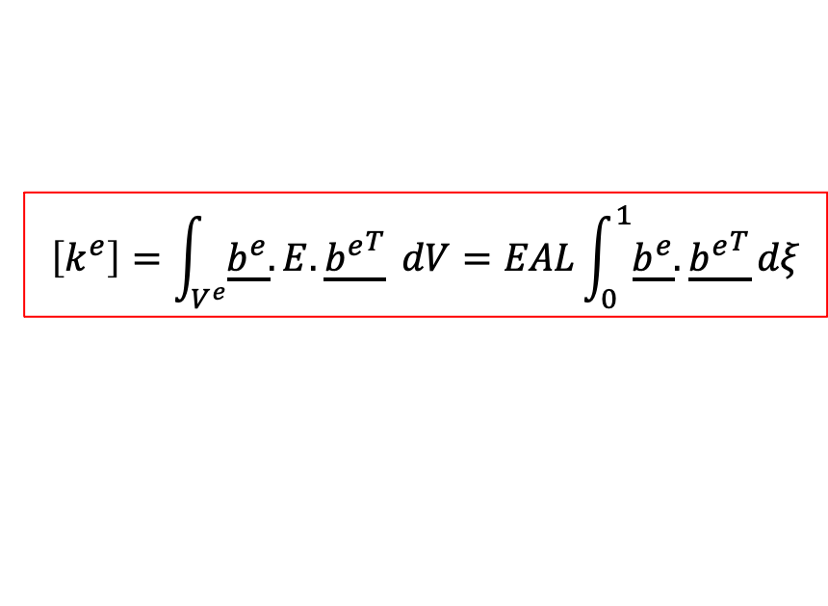
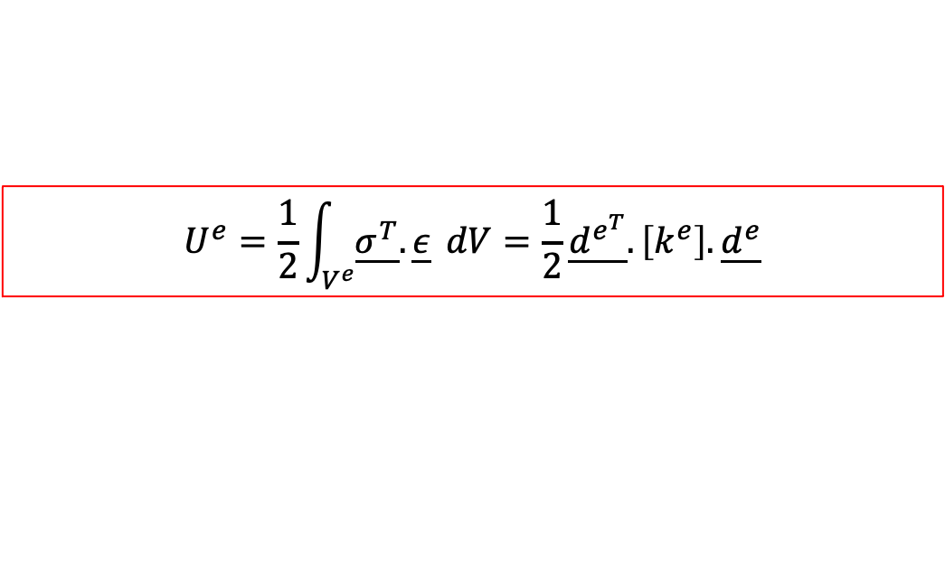

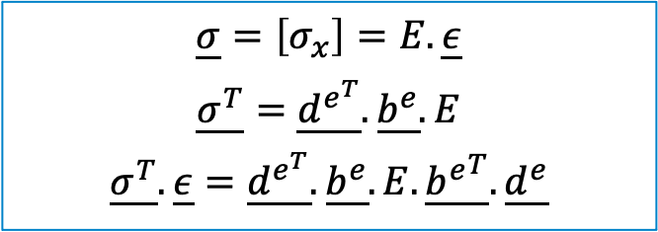
3a. General Bar Element
Elastic strain energy of an element
$$\underline{σ}=\left[σ_{x}\right]=E.\underline{ε}$$
$$\underline{σ^{T}}=\underline{d^{e^{T}}}.\underline{b^{e}}.E$$
$$\underline{σ^{T}}.\underline{ε}=\underline{d^{e^{T}}}.\underline{b^{e}}.E.\underline{{b^{e}}^{T}}.\underline{d^{e}}$$
$$U^{e}=\frac{1}{2}\int_{V^{e}}{\underline{σ^{T}}.\underline{ε}} dV=\frac{1}{2}\underline{d^{e^{T}}}.\left[k^{e}\right].\underline{d^{e}}$$
Where
$$\left[k^{e}\right]=\int_{V^{e}}{\underline{b^{e}}.E.\underline{{b^{e}}^{T}}} dV=EAL\int_{0}^{1}{\underline{b^{e}}.\underline{{b^{e}}^{T}}}dξ$$
$$Eq 2$$
Elemental stiffness matrix

Slide 11
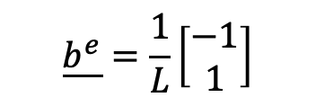

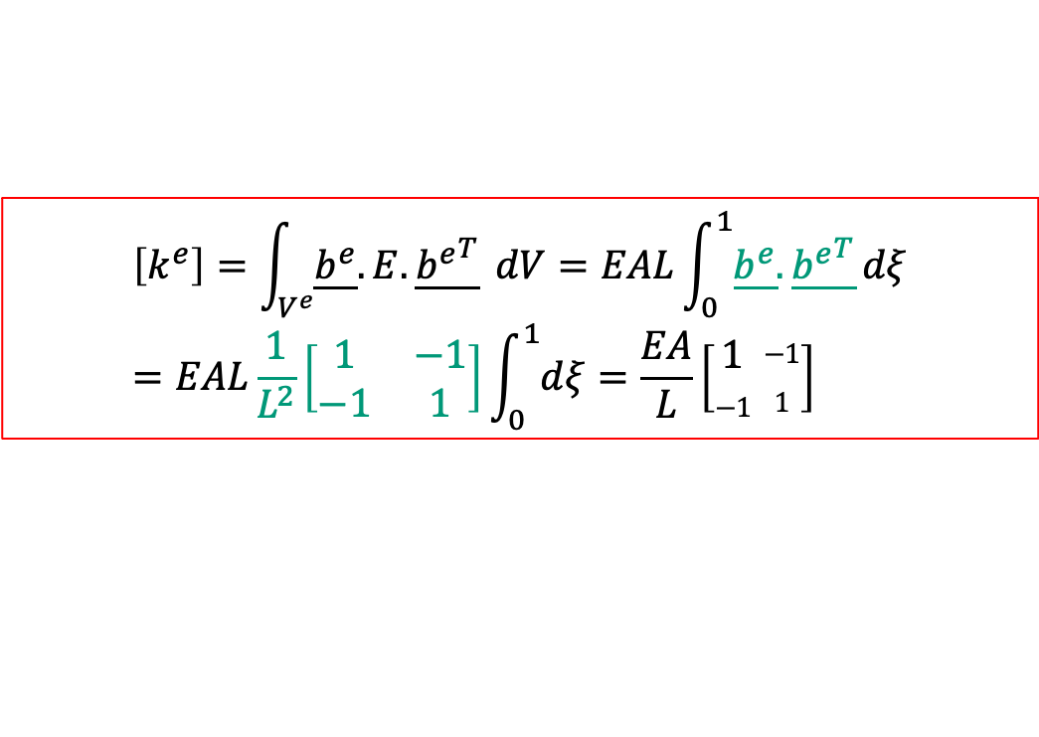
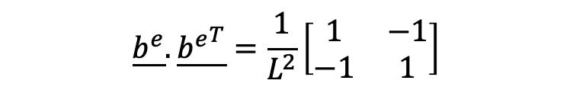
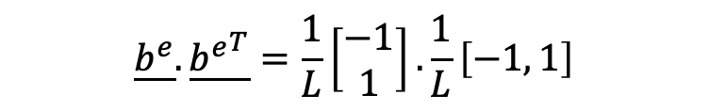
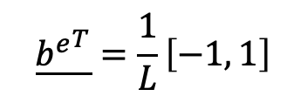
3a. General Bar Element
Check
$$\underline{b^{e}}=\frac{1}{L}\left[\begin{aligned}−1 \\ 1\end{aligned}\right]$$
$$\underline{{b^{e}}^{T}}=\frac{1}{L}\left[−1, 1\right]$$
So
$$\underline{b^{e}}.\underline{{b^{e}}^{T}}=\frac{1}{L}\left[\begin{aligned}−1 \\ 1\end{aligned}\right].\frac{1}{L}\left[−1, 1\right]$$
$$\underline{b^{e}}.\underline{{b^{e}}^{T}}=\frac{1}{L^{2}}\left[\begin{matrix}1 & −1 \\ −1 & 1\end{matrix}\right]$$
Substitute$\underline{{ b}^{e}}.\underline{{b^{e}}^{T}}$in $Eq 2$
$$\left[k^{e}\right]=\int_{V^{e}}{\underline{b^{e}}.E.\underline{{b^{e}}^{T}}} dV=EAL\int_{0}^{1}{\underline{b^{e}}.\underline{{b^{e}}^{T}}}dξ=EAL\frac{1}{L^{2}}\left[\begin{matrix}1 & −1 \\ −1 & 1\end{matrix}\right]\int_{0}^{1}{dξ}=\frac{EA}{L}\left[\begin{aligned}1 \\ −1\end{aligned} \begin{aligned}−1 \\ 1\end{aligned}\right]$$

Slide 12
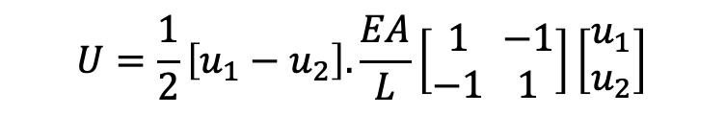
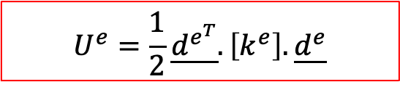
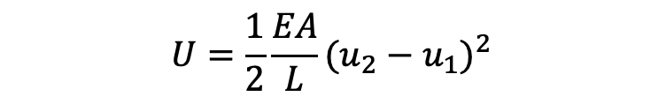
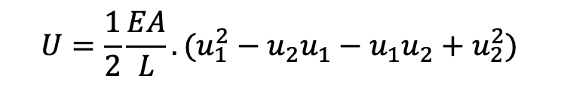
3a. General Bar Element
Total strain energy
Elemental strain energy
$$U^{e}=\frac{1}{2}\underline{d^{e^{T}}}.\left[k^{e}\right].\underline{d^{e}}$$
$$U=\frac{1}{2}\left[u_{1}−u_{2}\right].\frac{EA}{L}\left[\begin{aligned}1 \\ −1\end{aligned} \begin{aligned}−1 \\ 1\end{aligned}\right]\left[\begin{aligned}u_{1} \\ u_{2}\end{aligned}\right]$$
$$U=\frac{1}{2}\frac{EA}{L}.(u_{1}^{2}−u_{2}u_{1}−u_{1}u_{2}+u_{2}^{2})$$
$$U=\frac{1}{2}\frac{EA}{L}{(u_{2}−u_{1})}^{2}$$

Slide 13
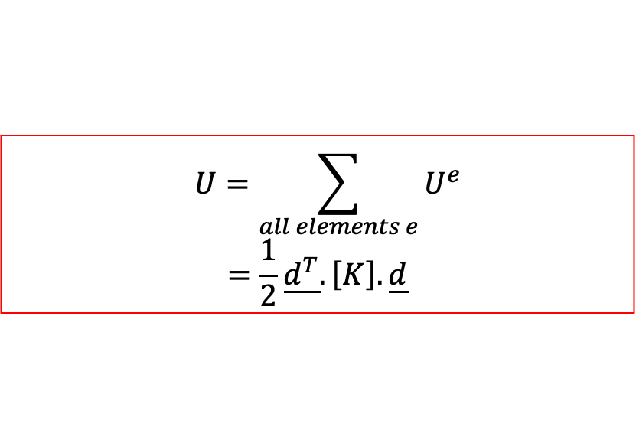
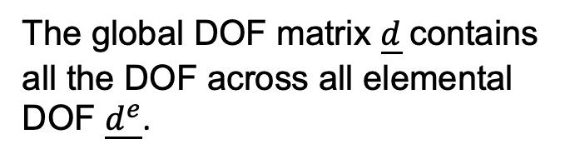
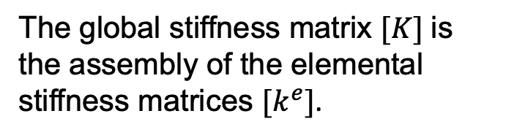
3a. General Bar Element
Total strain energy
Elemental strain energy
$$U^{e}=\frac{1}{2}\underline{d^{e^{T}}}.\left[k^{e}\right].\underline{d^{e}}$$
Total strain energy
$$U=\sum_{all elements e}{U^{e}}$$
$$=\frac{1}{2}\underline{d^{T}}.\left[K\right].\underline{d}$$
The global stiffness matrix $[K]$ is the assembly of the elemental stiffness matrices $[k^{e}]$.
The global DOF matrix $\underline{d}$ contains all the DOF across all elemental DOF $\underline{d^{e}}$.

Slide 14

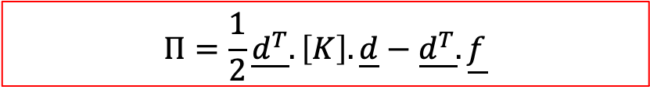
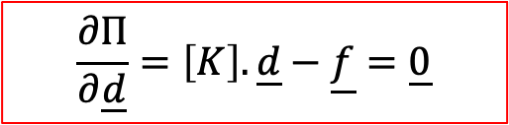


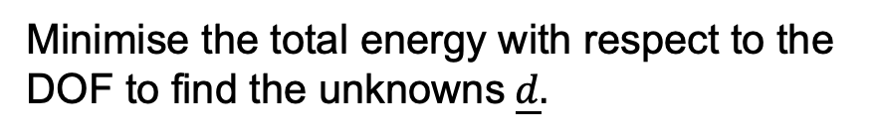
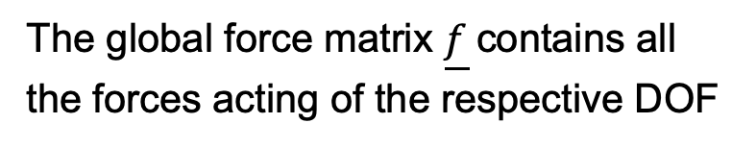

3a. General Bar Element
Finite Element Method
Potential energy of the applied loads
$$Ω=−\underline{d^{T}}.\underline{f}$$
The global force matrix $\underline{f}$ contains all the forces acting of the respective DOF
Total energy
$$Π=\frac{1}{2}\underline{d^{T}}.\left[K\right].\underline{d}−\underline{d^{T}}.\underline{f}$$
Minimise the total energy with respect to the DOF to find the unknowns $\underline{d}.$
A quadratic function of $\underline{d}$
Solution
$$\frac{∂Π}{∂\underline{d}}=\left[K\right].\underline{d}−\underline{f}=\underline{0}$$
$$⟹$$
$$\left[K\right].\underline{d}=\underline{f}$$

Slide 15
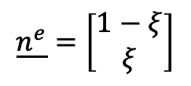
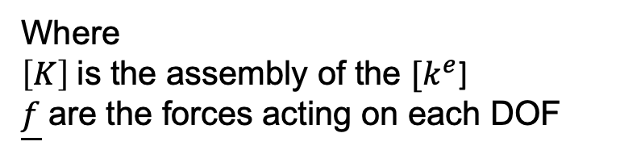

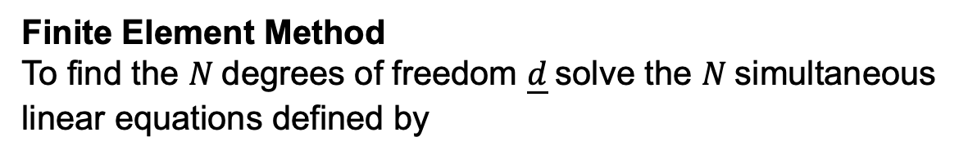
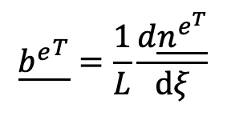
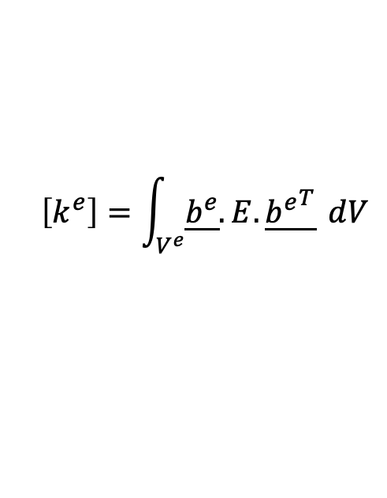
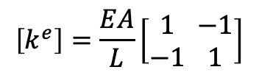

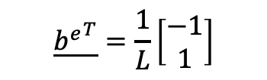
3a. FEM Summary
Finite Element Method
To find the $N$ degrees of freedom $\underline{d}$ solve the $N$ simultaneous linear equations defined by
$$\left[K\right].\underline{d}=\underline{f}$$
All FEM problems can be written in this form.
Where
$\left[K\right]$ is the assembly of the $[k^{e}$]
$\underline{f}$ are the forces acting on each DOF
For a linear bar element
Elemental Matrices
Defined by assumed displacement field.
In 1D
$$\underline{n^{e}}=\left[\begin{aligned}1−ξ \\ ξ\end{aligned}\right]$$
$$u\left(x\right)=\underline{{n^{e}}^{T}}.\underline{d^{e}}$$
$$\underline{{b^{e}}^{T}}=\frac{1}{L}\left[\begin{aligned}−1 \\ 1\end{aligned}\right]$$
$$\underline{{b^{e}}^{T}}=\frac{1}{L}\frac{d\underline{n^{e^{T}}}}{dξ}$$
$$⟹$$
$$\left[k^{e}\right]=\frac{EA}{L}\left[\begin{aligned}1 \\ −1\end{aligned} \begin{aligned}−1 \\ 1\end{aligned}\right]$$
$$\left[k^{e}\right]=\int_{V^{e}}{\underline{b^{e}}.E.\underline{{b^{e}}^{T}}} dV$$

Slide 16


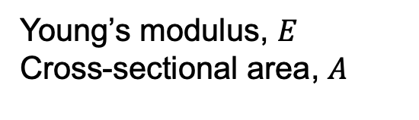


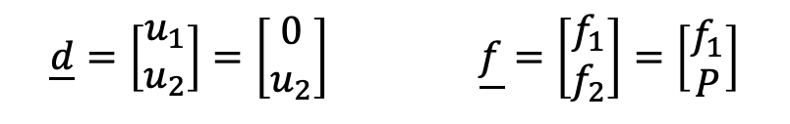








3b. Bar Element Example 1
Length, $L$
Load, $P$
Young’s modulus, $E$
Cross-sectional area, $A$
Unknown DOF in red.
$$u_{1}=0$$
$$u_{2}=?$$
Displacements
$$1$$
$$1$$
$$2$$
$$f_{1}=?$$
$$f_{2}=P$$
Forces
$$1$$
$$1$$
$$2$$
In general, either the displacement OR the force at a node is known, but never NEITHER or BOTH.
$$\underline{d}=\left[\begin{aligned}u_{1} \\ u_{2}\end{aligned}\right]=\left[\begin{aligned}0 \\ u_{2}\end{aligned}\right] \underline{f}=\left[\begin{aligned}f_{1} \\ f_{2}\end{aligned}\right]=\left[\begin{aligned}f_{1} \\ P\end{aligned}\right]$$

Slide 17




3b. Bar Element Example 1
All that is needed is the elemental stiffness matrix.
For element (1)
$$\left[k^{(1)}\right]=\frac{EA}{L}\left[\begin{aligned}1 \\ −1\end{aligned} \begin{aligned}−1 \\ 1\end{aligned}\right] \underline{d^{(1)}}=\left[\begin{aligned}u_{1} \\ u_{2}\end{aligned}\right]$$
As only one element the elemental matrix is the same as the global matrix so no “assembly” required.
$$\left[K\right]=\left[k^{(1)}\right]=\frac{EA}{L}\left[\begin{aligned}1 \\ −1\end{aligned} \begin{aligned}−1 \\ 1\end{aligned}\right]$$
$$\frac{EA}{L}\left[\begin{aligned}1 \\ −1\end{aligned} \begin{aligned}−1 \\ 1\end{aligned}\right]\left[\begin{aligned}0 \\ u_{2}\end{aligned}\right]=\left[\begin{aligned}f_{1} \\ P\end{aligned}\right]$$
$$\left[K\right].\underline{d}=\underline{f}$$
$$⟹$$

Slide 18





3b. Bar Element Example 1
Two equations for 2 unknowns ($u_{2}$ and $f_{1}$)
$$\frac{EA}{L}\left[\begin{aligned}1 \\ −1\end{aligned} \begin{aligned}−1 \\ 1\end{aligned}\right]\left[\begin{aligned}0 \\ u_{2}\end{aligned}\right]=\left[\begin{aligned}f_{1} \\ P\end{aligned}\right]$$
$$\frac{EA}{L}\left(1 ×0−1×u_{2}\right)=f_{1}$$
$$Eq 1$$
$$\frac{EA}{L}\left(−1 ×0+1×u_{2}\right)=P$$
$$Eq 2$$

Slide 19









3b. Bar Element Example 1
Second equation gives
$$\frac{EA}{L}\left(−1 ×0+1×u_{2}\right)=P$$
Partition
$$\frac{EA}{L}u_{2}=P$$
$$⟹$$
$$u_{2}=\frac{PL}{EA}$$
Same as previous solution as same linear shape function
First equation gives
$$\frac{EA}{L}\left(1 ×0−1×u_{2}\right)=f_{1}$$
$$−\frac{EA}{L}u_{2}=f_{1}$$
$$⟹$$
Substitute${ u}_{2}$ in $Eq 1$
This is the reaction force provided by the wall to keep the displacement $u_{1}=0$.
$$f_{1}=−P$$

Slide 20










3b. Bar Element Example 1
Length, $L$
Load, $P$
Young’s modulus, $E$
Cross-sectional area, $A$
$$u_{2}=\frac{PL}{EA}$$
$$u_{1}=0$$
Displacements
$$1$$
$$1$$
$$2$$
$$f_{1}=P$$
$$f_{2}=P$$
Forces
$$1$$
$$1$$
$$2$$

Slide 21
















3b. Bar Element Example 2 : Self weight
Displacements
Forces
$$1$$
$$1$$
$$x$$
Length, $L$
1
$$f_{1}=?$$
$$u_{1}=0$$
$$2$$
$$2$$
$$f_{x}$$
$$u_{2}=?$$
2
$$f_{2}$$
$$3$$
$$3$$
Body force: $f_{x}=ρg$
$$u_{3}=?$$
$$f_{3}$$
From section 2b, we know exact solution is a quadratic.
Here we use two linear bar elements to get an approximate solution.

Slide 22




3b. Bar Element Example 2 : Self weight
Forces due to distributed load
$$Ω^{e}=−\int_{V^{e}}{f_{x}u\left(x\right) dx=−AL^{e}\int_{0}^{1}{ρg.}}\underline{{n^{e}}^{T}}\left(ξ\right)dξ.\underline{d^{e}}=−\underline{{f^{e}}^{T}}.\underline{d^{e}}$$
So
$$\underline{f^{e}}=AL^{e}ρg\int_{0}^{1}{\underline{n^{e}}\left(ξ\right)dξ=AL^{e}ρg\int_{0}^{1}{\left[\begin{aligned}1−ξ \\ ξ\end{aligned}\right]dξ=AL^{e}ρg{\left[\begin{aligned}ξ−{\frac{1}{2}ξ}^{2} \\ {\frac{1}{2}ξ}^{2}\end{aligned}\right]}_{0}^{1}}}$$
$$\underline{f^{e}}=AL^{e}ρg\left[\begin{matrix}1/2 \\ 1/2\end{matrix}\right]=\frac{AL^{e}ρg}{2}\left[\begin{aligned}1 \\ 1\end{aligned}\right]$$
$$L^{e}=\frac{L}{2}$$
Where
Each element is half the total length $L$

Slide 23





3b. Bar Element Example 2 : Self weight
Global matrices
$$\underline{d}=\left[\begin{matrix}u_{1} \\ u_{2} \\ u_{3}\end{matrix}\right]=\left[\begin{matrix}0 \\ u_{2} \\ u_{3}\end{matrix}\right]$$
$$\underline{f}=\left[\begin{matrix}f_{1} \\ f_{2} \\ f_{3}\end{matrix}\right]$$
Elemental stiffness matrices
$$\begin{matrix}u_{1} & u_{2}\end{matrix}$$
Element (1)
$$\left[k^{(1)}\right]=\frac{EA}{\frac{1}{2}L}\left[\begin{aligned}1 \\ −1\end{aligned} \begin{aligned}−1 \\ 1\end{aligned}\right] \begin{matrix}u_{1} \\ u_{2}\end{matrix} \underline{d^{(1)}}=\left[\begin{aligned}u_{1} \\ u_{2}\end{aligned}\right]$$
Force due to unknown reaction at node 1
Applied load due to self weight
$$\underline{f^{(1)}}=\frac{A\frac{L}{2}ρg}{2}\left[\begin{aligned}1 \\ 1\end{aligned}\right]+\left[\begin{aligned}f_{1} \\ f_{2}\end{aligned}\right]=\frac{ALρg}{4}\left[\begin{aligned}1 \\ 1\end{aligned}\right]+\left[\begin{aligned}f_{1} \\ 0\end{aligned}\right]$$

Slide 24




3b. Bar Element Example 2 : Self weight
$$\begin{matrix}u_{2} & u_{3}\end{matrix}$$
$$\left[k^{(2)}\right]=\frac{EA}{\frac{1}{2}L}\left[\begin{aligned}1 \\ −1\end{aligned} \begin{aligned}−1 \\ 1\end{aligned}\right]\begin{matrix}u_{2} \\ u_{3}\end{matrix} \underline{d^{(2)}}=\left[\begin{aligned}u_{2} \\ u_{3}\end{aligned}\right]$$
Element (2)
$$\underline{f^{(2)}}=\frac{ALρg}{4}\left[\begin{aligned}1 \\ 1\end{aligned}\right]+\left[\begin{aligned}f_{2} \\ f_{3}\end{aligned}\right]=\frac{ALρg}{4}\left[\begin{aligned}1 \\ 1\end{aligned}\right]+\left[\begin{aligned}0 \\ 0\end{aligned}\right]$$
$$a=\frac{ALρg}{4}$$

Slide 25






3b. Bar Element Example 2 : Self weight
Assembly of elemental force matrices
$$u_{1}$$
$$\underline{f}=\left[\begin{aligned}{a+f}_{1} \\ a+a \\ a\end{aligned}\right]$$
$$u_{2}$$
$$u_{3}$$
Element (1)
Element (2)
$$\underline{f^{(1)}}=a\left[\begin{aligned}1 \\ 1\end{aligned}\right]+\left[\begin{aligned}f_{1} \\ 0\end{aligned}\right]\begin{matrix}u_{1} \\ u_{2}\end{matrix}$$
$$\underline{f^{(2)}}=a\left[\begin{aligned}1 \\ 1\end{aligned}\right]+\left[\begin{aligned}0 \\ 0\end{aligned}\right]\begin{matrix}u_{2} \\ u_{3}\end{matrix}$$

Slide 26











3b. Bar Element Example 2 : Self weight
Global stiffness matrix
$$u_{1}$$
$$u_{2}$$
$$u_{3}$$
$$\left[K\right]=\frac{2EA}{L}\left[\begin{aligned}1 \\ −1 \\ 0\end{aligned} \begin{aligned}−1 \\ 1+1 \\ −1\end{aligned} \begin{aligned}0 \\ −1 \\ 1\end{aligned}\right]$$
$$u_{1}$$
$$u_{2}$$
$$u_{3}$$
Element (1)
Element (2)
$$\begin{matrix}u_{1} & u_{2}\end{matrix}$$
$$\begin{matrix}u_{2} & u_{3}\end{matrix}$$
$$\left[k^{(1)}\right]=\frac{2EA}{L}\left[\begin{aligned}1 \\ −1\end{aligned} \begin{aligned}−1 \\ 1\end{aligned}\right] \begin{matrix}u_{1} \\ u_{2}\end{matrix}$$
$$\left[k^{(2)}\right]=\frac{2EA}{L}\left[\begin{aligned}1 \\ −1\end{aligned} \begin{aligned}−1 \\ 1\end{aligned}\right]\begin{matrix}u_{2} \\ u_{3}\end{matrix}$$

Slide 27







3b. Bar Element Example 2 : Self weight
$$\frac{2EA}{L}\left[\begin{aligned}1 \\ −1 \\ 0\end{aligned} \begin{aligned}−1 \\ 2 \\ −1\end{aligned} \begin{aligned}0 \\ −1 \\ 1\end{aligned}\right]\left[\begin{aligned}0 \\ u_{2} \\ u_{3}\end{aligned}\right]=\left[\begin{aligned}{a+f}_{1} \\ 2a \\ a\end{aligned}\right]$$
$$\left[K\right].\underline{d}=\underline{f}$$
$$⟹$$
$$Eq 3$$
$$a=\frac{ALρg}{4}$$
As in previous example, partition out 2nd and 3rd equations where forces are known
$$\frac{2EA}{L}\left[\begin{aligned}2 \\ −1\end{aligned} \begin{aligned}−1 \\ 1\end{aligned}\right]\left[\begin{aligned}u_{2} \\ u_{3}\end{aligned}\right]=\left[\begin{aligned}2a \\ a\end{aligned}\right]$$
Matrix inversion (reminder)
$${\left[\begin{aligned}a \\ c\end{aligned} \begin{aligned}b \\ d\end{aligned}\right]}^{−1}=\frac{1}{(ad−bc)}{\left[\begin{aligned}d \\ −c\end{aligned} \begin{aligned}−b \\ a\end{aligned}\right]}^{ }$$
$$\left[\begin{aligned}u_{2} \\ u_{3}\end{aligned}\right]=\frac{La}{2EA}{\left[\begin{aligned}2 \\ −1\end{aligned} \begin{aligned}−1 \\ 1\end{aligned}\right]}^{−1}\left[\begin{aligned}2 \\ 1\end{aligned}\right]$$

Slide 28










3b. Bar Element Example 2 : Self weight
$${\left[\begin{aligned}2 \\ −1\end{aligned} \begin{aligned}−1 \\ 1\end{aligned}\right]}^{−1}=\frac{1}{(2×1−{\left(−1\right)}^{2})}\left[\begin{aligned}1 \\ 1\end{aligned} \begin{aligned}1 \\ 2\end{aligned}\right]=\frac{1}{2−1}\left[\begin{aligned}1 \\ 1\end{aligned} \begin{aligned}1 \\ 2\end{aligned}\right]=\left[\begin{aligned}1 \\ 1\end{aligned} \begin{aligned}1 \\ 2\end{aligned}\right]$$
$$a$$
$$\left[\begin{aligned}u_{2} \\ u_{3}\end{aligned}\right]=\frac{L}{2EA}×\frac{ALρg}{4}\left[\begin{aligned}1 \\ 1\end{aligned} \begin{aligned}1 \\ 2\end{aligned}\right]\left[\begin{aligned}2 \\ 1\end{aligned}\right]=\frac{L^{2}ρg}{8E}\left[\begin{aligned}3 \\ 4\end{aligned}\right]$$
First equation from $Eq 3$ then gives
$$\frac{2EA}{L}\left[1.\left(0\right)−1.\left(u_{2}\right). 0(u_{3})\right]{=a+f}_{1}$$
$${a+f}_{1}=\frac{2EA}{L}\left(−u_{2}\right)=−\frac{2EA}{L}.\frac{{3L}^{2}ρg}{8E}=−\frac{3ALρg}{4}$$
$$⟹$$
Reaction = weight of bar
$$f_{1}=−\frac{3ALρg}{4}−\frac{ALρg}{4}=−ALρg\left(\frac{3}{4}+\frac{1}{4}\right)$$
$$⟹$$
$$⟹$$
$$f_{1}=−ALρg$$

Slide 29






3b. Bar Element Example 2 : Self weight
$$u$$
Exact quadratic solution
$$\frac{ρgL^{2}}{2E}$$
2 element linear approx.
$$\frac{3ρgL^{2}}{8E}$$
1 element linear approx.
$$x$$
$$\frac{1}{2}L$$
$$L$$

Slide 30













3c. Bar elements for 2D frameworks
Consider a bar element with orientation $θ$. In 2D the horizontal and vertical displacements are $u$ and $v$.
$$v_{2}$$
DOF
$$2$$
$$u_{2}$$
Length, $L$
$$v_{1}$$
$$θ$$
$$1$$
$$u_{1}$$
Only displacements parallel to bar axis cause extension/compression
$$u_{1}\cos{θ+v_{1}\sin{θ}}$$
$$u_{2}\cos{θ+v_{2}\sin{θ}}$$
$$1$$
$$2$$

Slide 31








3c. Bar elements for 2D frameworks
Elemental strain energy
$$U^{e}=\frac{1}{2}\underline{d^{e^{T}}}.\left[k^{e}\right].\underline{d^{e}}$$
$$\underline{d^{e}}=\left[\begin{aligned}u_{1} \\ u_{2}\end{aligned}\right]$$
$$\left[k^{e}\right]=\frac{EA}{L}\left[\begin{aligned}1 \\ −1\end{aligned} \begin{aligned}−1 \\ 1\end{aligned}\right]$$
$$\underline{d^{e}}=\left[\begin{aligned}u_{1}\cos{θ+v_{1}\sin{θ}} \\ u_{2}\cos{θ+v_{2}\sin{θ}}\end{aligned}\right]$$
$$U^{e}=\frac{1}{2}\left[\begin{matrix}u_{1} & u_{2}\end{matrix}\right].\frac{EA}{L}\left[\begin{aligned}1 \\ −1\end{aligned} \begin{aligned}−1 \\ 1\end{aligned}\right].\left[\begin{aligned}u_{1} \\ u_{2}\end{aligned}\right]$$
$$U^{e}=\frac{1}{2}\left[\begin{matrix}u_{1} & u_{2}\end{matrix}\right].\frac{EA}{L}\left[\begin{aligned}u_{1} \\ −u_{1}\end{aligned} \begin{aligned}{−u}_{2} \\ u_{2}\end{aligned}\right]$$
$$U^{e}=\frac{1}{2}\frac{EA}{L}[u_{1}\left(u_{1}−u_{2}\right)+u_{2}(−u_{1}+u_{2})]$$
$$U^{e}=\frac{1}{2}\frac{EA}{L}{(u_{2}−u_{1})}^{2}$$

Slide 32











3c. Bar elements for 2D frameworks
$$U^{e}=\frac{1}{2}\frac{EA}{L}{(u_{2}−u_{1})}^{2}$$
$$U^{e}=\frac{1}{2}\frac{EA}{L}{\left(u_{2}\cos{θ+v_{2}\sin{θ}}−u_{1}\cos{θ−v_{1}\sin{θ}}\right)}^{2}$$
$$U^{e}=\frac{1}{2}\underline{d^{e^{T}}}.\left[k^{e}\right].\underline{d^{e}}$$
We wish to consider the four nodal DOF separately.
It is easy to show that $U^{e}$ is the same with
$$u_{1}$$
$$v_{1}$$
$$u_{2}$$
$$v_{2}$$
$$\left[k^{e}\right]=\frac{EA}{L}\left[\begin{aligned}&\cos^{2}{θ} \\ &\cos{θ\sin{θ}} \\ &−\cos^{2}{θ} \\ &−\cos{θ\sin{θ}}\end{aligned} \begin{aligned}&\cos{θ\sin{θ}} \\ &\sin^{2}{θ} \\ &−\cos{θ\sin{θ}} \\ &−\sin^{2}{θ}\end{aligned} \begin{aligned}&−\cos^{2}{θ} \\ &−\cos{θ\sin{θ}} \\ &\cos^{2}{θ} \\ &\cos{θ\sin{θ}}\end{aligned} \begin{aligned}&−\cos{θ\sin{θ}} \\ &−\sin^{2}{θ} \\ &\cos{θ\sin{θ}} \\ &\sin^{2}{θ}\end{aligned}\right]$$
$$\underline{d^{e}}=\left[\begin{aligned}u_{1} \\ v_{1} \\ u_{2} \\ v_{2}\end{aligned}\right]$$
$\begin{aligned}u_{1} \\ v_{1} \\ u_{2} \\ v_{2}\end{aligned}$

Slide 33






3c. Framework Example
Using two linear bar elements, find the unknown nodal displacements and forces, assuming $E$ and $A$ same for both bars
$$L$$
$$L$$
$$\sqrt{2}L$$
$${45}^{o}$$
$$mg$$

Slide 34

















3c. Framework Example
Displacements
Forces
$$v_{2}$$
$$S_{2}=−P$$
$$v_{1}=0$$
$$S_{1}$$
$$u_{1}=0$$
$$u_{2}$$
$$R_{1}$$
$$R_{2}=0$$
1
$$1$$
2
1
$$1$$
2
$$v_{3}=0$$
$$2$$
$$S_{3}$$
$$2$$
3
$$u_{3}=0$$
3
$$R_{3}$$
$$P=mg$$
Unknown DOF in red.

Slide 35





3c. Framework Example
Element (1)
$$\underline{d^{(1)}}=\left[\begin{aligned}u_{1} \\ v_{1} \\ u_{2} \\ v_{2}\end{aligned}\right]$$
$$\underline{f_{ }}=\left[\begin{aligned}R_{1} \\ S_{1} \\ R_{2} \\ S_{2}\end{aligned}\right]$$
Element 1 $(θ=0^{0})$
$$\cos^{2}{0^{o}=1 \cos{0^{o}\sin{0^{o}=\sin^{2}{0^{o}=0}}}}$$
$$\left[k^{(1)}\right]=k_{1}\left[\begin{aligned}1 \\ 0 \\ −1 \\ 0\end{aligned} \begin{aligned}0 \\ 0 \\ 0 \\ 0\end{aligned} \begin{aligned}−1 \\ 0 \\ 1 \\ 0\end{aligned} \begin{aligned}0 \\ 0 \\ 0 \\ 0\end{aligned}\right] k_{1}=\frac{EA}{L}$$

Slide 36





3c. Framework Example
Element (2)
$$\underline{d^{(2)}}=\left[\begin{aligned}u_{3} \\ v_{3} \\ u_{2} \\ v_{2}\end{aligned}\right]$$
$$\underline{f_{ }}=\left[\begin{aligned}R_{3} \\ S_{3} \\ R_{2} \\ S_{2}\end{aligned}\right]$$
$$\cos^{2}{{45}^{o}=\cos{{45}^{o}\sin{{45}^{o}=\sin^{2}{{45}^{o}=\frac{1}{2}}}}}$$
Element 2 $(θ=45^{o})$
$$\left[k^{(2)}\right]=k_{2}\left[\begin{aligned}1 \\ 1 \\ −1 \\ −1\end{aligned} \begin{aligned}1 \\ 1 \\ −1 \\ −1\end{aligned} \begin{aligned}−1 \\ −1 \\ 1 \\ 1\end{aligned} \begin{aligned}−1 \\ −1 \\ 1 \\ 1\end{aligned}\right] k_{2}=\frac{EA}{2\sqrt{2}L}$$

Slide 37














3c. Framework Example
Assemble global matrices
$$\begin{matrix}u_{1} & v_{1} & u_{2} & v_{2}\end{matrix}$$
$$\begin{matrix}u_{3} & v_{3} & u_{2} & v_{2}\end{matrix}$$
$$\left[k^{(2)}\right]=k_{2}\left[\begin{aligned}1 \\ 1 \\ −1 \\ −1\end{aligned} \begin{aligned}1 \\ 1 \\ −1 \\ −1\end{aligned} \begin{aligned}−1 \\ −1 \\ 1 \\ 1\end{aligned} \begin{aligned}−1 \\ −1 \\ 1 \\ 1\end{aligned}\right]$$
$$\left[k^{(1)}\right]=k_{1}\left[\begin{aligned}1 \\ 0 \\ −1 \\ 0\end{aligned} \begin{aligned}0 \\ 0 \\ 0 \\ 0\end{aligned} \begin{aligned}−1 \\ 0 \\ 1 \\ 0\end{aligned} \begin{aligned}0 \\ 0 \\ 0 \\ 0\end{aligned}\right]$$
$$\begin{aligned}u_{1} \\ v_{1} \\ u_{2} \\ v_{2}\end{aligned}$$
$$\begin{aligned}u_{3} \\ v_{3} \\ u_{2} \\ v_{2}\end{aligned}$$
$$k_{2}=\frac{EA}{2\sqrt{2}L}$$
$$k_{1}=\frac{EA}{L}$$
$$\begin{matrix}u_{1} & { v}_{1}\end{matrix}$$
$$\begin{matrix}u_{2} & { v}_{2}\end{matrix}$$
$$\begin{matrix}u_{3} & { v}_{3}\end{matrix}$$
$$\underline{d_{ }}=\left[\begin{aligned}&u_{1} \\ &v_{1} \\ &u_{2} \\ &v_{2} \\ &u_{3} \\ &v_{3}\end{aligned}\right]$$
$$\left[K_{ }\right]=\left[\begin{aligned}&k_{1} \\ &0 \\ &−k_{1} \\ &0 \\ &0 \\ &0\end{aligned} \begin{aligned}&0 \\ &0 \\ &0 \\ &0 \\ &0 \\ &0\end{aligned} \begin{aligned}&−k_{1} \\ &0 \\ &k_{1}+k_{2} \\ &k_{2} \\ &−k_{2} \\ &−k_{2}\end{aligned} \begin{aligned}&0 \\ &0 \\ &k_{2} \\ &k_{2} \\ &−k_{2} \\ &−k_{2}\end{aligned} \begin{aligned}&0 \\ &0 \\ &{−k}_{2} \\ &−k_{2} \\ &k_{2} \\ &k_{2}\end{aligned} \begin{aligned}&0 \\ &0 \\ &{−k}_{2} \\ &−k_{2} \\ &k_{2} \\ &k_{2}\end{aligned}\right]$$
$$\begin{aligned}&u_{1} \\ &v_{1} \\ &u_{2} \\ &v_{2} \\ &u_{3} \\ &v_{3}\end{aligned}$$

Slide 38



3c. Framework Example
Assemble global matrices
$$\left[K_{ }\right]=\left[\begin{aligned}&k_{1} \\ &0 \\ &−k_{1} \\ &0 \\ &0 \\ &0\end{aligned} \begin{aligned}&0 \\ &0 \\ &0 \\ &0 \\ &0 \\ &0\end{aligned} \begin{aligned}&−k_{1} \\ &0 \\ &k_{1}+k_{2} \\ &k_{2} \\ &−k_{2} \\ &−k_{2}\end{aligned} \begin{aligned}&0 \\ &0 \\ &k_{2} \\ &k_{2} \\ &−k_{2} \\ &−k_{2}\end{aligned} \begin{aligned}&0 \\ &0 \\ &{−k}_{2} \\ &−k_{2} \\ &k_{2} \\ &k_{2}\end{aligned} \begin{aligned}&0 \\ &0 \\ &{−k}_{2} \\ &−k_{2} \\ &k_{2} \\ &k_{2}\end{aligned}\right]$$
$$\underline{d_{ }}=\left[\begin{aligned}&u_{1} \\ &v_{1} \\ &u_{2} \\ &v_{2} \\ &u_{3} \\ &v_{3}\end{aligned}\right]=\left[\begin{aligned}&0 \\ &0 \\ &u_{2} \\ &v_{2} \\ &0 \\ &0\end{aligned}\right]$$
$$\underline{f_{ }}=\left[\begin{aligned}&R_{1} \\ &S_{1} \\ &R_{2} \\ &S_{2} \\ &R_{3} \\ &S_{3}\end{aligned}\right]=\left[\begin{aligned}&R_{1} \\ &S_{1} \\ &0 \\ &−P \\ &R_{3} \\ &S_{3}\end{aligned}\right]$$

Slide 39



3c. Framework Example
Solution
$\left[\begin{aligned}&k_{1} \\ &0 \\ &−k_{1} \\ &0 \\ &0 \\ &0\end{aligned} \begin{aligned}&0 \\ &0 \\ &0 \\ &0 \\ &0 \\ &0\end{aligned} \begin{aligned}&−k_{1} \\ &0 \\ &k_{1}+k_{2} \\ &k_{2} \\ &−k_{2} \\ &−k_{2}\end{aligned} \begin{aligned}&0 \\ &0 \\ &k_{2} \\ &k_{2} \\ &−k_{2} \\ &−k_{2}\end{aligned} \begin{aligned}&0 \\ &0 \\ &{−k}_{2} \\ &−k_{2} \\ &k_{2} \\ &k_{2}\end{aligned} \begin{aligned}&0 \\ &0 \\ &{−k}_{2} \\ &−k_{2} \\ &k_{2} \\ &k_{2}\end{aligned}\right]\left[\begin{aligned}&0 \\ &0 \\ &u_{2} \\ &v_{2} \\ &0 \\ &0\end{aligned}\right]$=$\left[\begin{aligned}&R_{1} \\ &S_{1} \\ &0 \\ &−P \\ &R_{3} \\ &S_{3}\end{aligned}\right]$
$$\left[K\right].\underline{d}=\underline{f}$$
$$⟹$$
Partition out 3rd and 4th equations where forces are known.
$$\left[\begin{matrix}k_{1}+k_{2} & k_{2} \\ k_{2} & k_{2}\end{matrix}\right]\left[\begin{matrix}u_{2} \\ v_{2}\end{matrix}\right]=\left[\begin{matrix}0 \\ −P\end{matrix}\right]$$

Slide 40



3c. Framework Example
Solution
$$\left[\begin{matrix}u_{2} \\ v_{2}\end{matrix}\right]=\frac{1}{\left(k_{1}+k_{2}\right)k_{2}−{k_{2}}^{2}}\left[\begin{matrix}k_{2} & −k_{2} \\ −k_{2} & k_{1}+k_{2}\end{matrix}\right]\left[\begin{aligned}&0 \\ &−P\end{aligned}\right]$$
$$\left[\begin{matrix}u_{2} \\ v_{2}\end{matrix}\right]=\frac{1}{k_{1}k_{2}}\left[\begin{matrix}k_{2}P \\ −\left(k_{1}+k_{2}\right)P\end{matrix}\right]$$
$$\left[\begin{matrix}u_{2} \\ v_{2}\end{matrix}\right]=P\left[\begin{matrix}\frac{1}{k_{1}} \\ −\left(\frac{1}{k_{1}}+\frac{1}{k_{2}}\right)\end{matrix}\right]$$
$$⟹$$

Slide 41





3c. Framework Example
Solution
Substitute known displacements into remaining equations to find unknown forces.
Node 1
$$\left[\begin{aligned}&R_{1} \\ &S_{1}\end{aligned}\right]=\left[\begin{matrix}−k_{1} & 0 \\ 0 & 0\end{matrix}\right].P \left[\begin{matrix}\frac{1}{k_{1}} \\ −\left(\frac{1}{k_{1}}+\frac{1}{k_{2}}\right)\end{matrix}\right]=P\left[\begin{aligned}&−1 \\ &0\end{aligned}\right]$$
$$\left[\begin{matrix}−k_{1} & 0 \\ 0 & 0\end{matrix}\right]\left[\begin{matrix}u_{2} \\ v_{2}\end{matrix}\right]=\left[\begin{aligned}&R_{1} \\ &S_{1}\end{aligned}\right]$$
$$⟹$$
Node 3
$$\left[\begin{aligned}&R_{3} \\ &S_{3}\end{aligned}\right]=\left[\begin{matrix}−k_{2} & −k_{2} \\ −k_{2} & −k_{2}\end{matrix}\right].P \left[\begin{matrix}\frac{1}{k_{1}} \\ −\left(\frac{1}{k_{1}}+\frac{1}{k_{2}}\right)\end{matrix}\right]=P\left[\begin{aligned}&1 \\ &1\end{aligned}\right]$$
$$\left[\begin{matrix}−k_{2} & −k_{2} \\ −k_{2} & −k_{2}\end{matrix}\right]\left[\begin{matrix}u_{2} \\ v_{2}\end{matrix}\right]=\left[\begin{aligned}&R_{3} \\ &S_{3}\end{aligned}\right]$$
$$⟹$$

Slide 42






3c. Framework Example
Displacements
Forces
$$P$$
$$\frac{P}{k_{1}}$$
$$P\left(\frac{1}{k_{1}}+\frac{1}{k_{2}}\right)$$
$$P$$
$$P$$
$$P$$

Slide 43

3c. COMSOL Practical #1
Solve this example and check solution is the same
Explore the effects of changing the angle from 45º using a parametric analysis.

Slide 44








3c. COMSOL Practical #1 (continued)
(3) Solve the examples in Exercise Sheet #3 and check results using COMSOL.
$$P$$
$$L$$
$${30}^{o}$$
$$L$$
$$L$$
$${60}^{o}$$
$${45}^{o}$$
$$P$$

Slide 45

3c. COMSOL Practical #2
Design of a truss bridge
http://blog.rasaayurveda.com

Slide 46
Next section…
(4) Beam Elements

